Slide 1
Operation of the Load vs. Displacement Analyzer
Joshua McGuckin
Associate Research Engineer

Slide 2
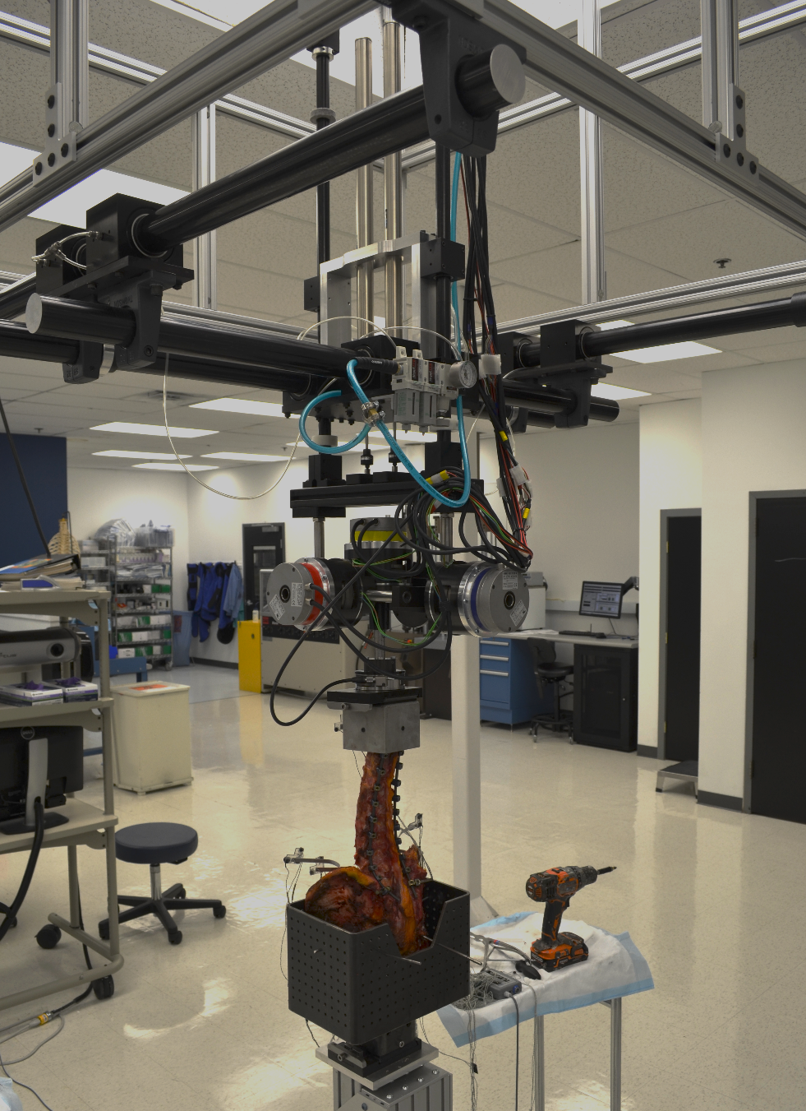
Range of Motion (ROM)
CC translation
AP Translation
The 6-degrees of freedom motion simulator (6DOF) allows us to quantify total range of motion (ROM) in the 6 directions
Flexion-Extension (FE)
Lateral Bending (LB)
Axial Rotation (AR)
Tells us how much spinal segments move during applied bending
Load cell cranial to the specimen measures applied torque in the direction of bending
Pneumatics ensure weightlessness of the specimen to achieve pure bending moments
i.e. equal torque at every level of the spine
ML Translation
Axial Rotation
Flexion Extension
Lateral Bending

Slide 3
Range of Motion (ROM)
CC translation
AP Translation
The 6-degrees of freedom motion simulator (6DOF) allows us to quantify total range of motion (ROM) in the 6 directions
Flexion-Extension (FE)
Lateral Bending (LB)
Axial Rotation (AR)
Tells us how much spinal segments move during applied bending
Load cell cranial to the specimen measures applied torque in the direction of bending
Pneumatics ensure weightlessness of the specimen to achieve pure bending moments
i.e. equal torque at every level of the spine
This is not yet validated!!!
ML Translation
Axial Rotation
Flexion Extension
Lateral Bending

Slide 4
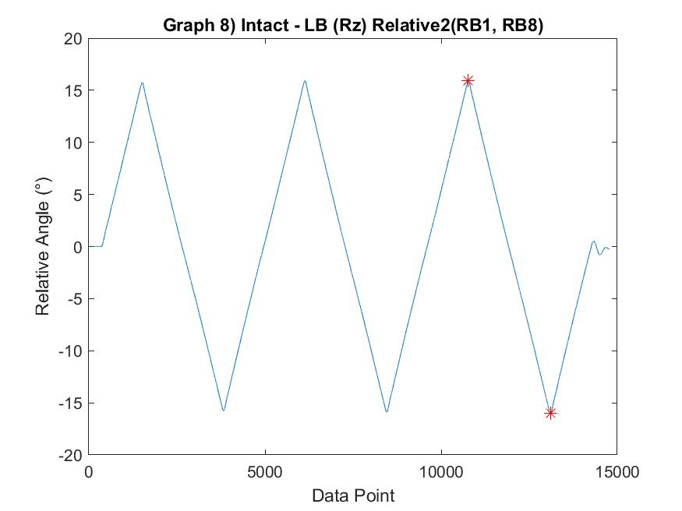
Range of Motion (ROM)
The 6-degrees of freedom motion simulator (6DOF) allows us to quantify total range of motion (ROM) in the 6 directions
Flexion-Extension (FE)
Lateral Bending (LB)
Axial Rotation (AR)
Tells us how much spinal segments move during applied bending
ROM

Slide 5
Range of Motion (ROM)
The 6-degrees of freedom motion simulator (6DOF) allows us to quantify total range of motion (ROM) in the 6 directions
Flexion-Extension (FE)
Lateral Bending (LB)
Axial Rotation (AR)
Tells us how much spinal segments move in each direction during applied bending
But there’s so much MORE!
ROM

Slide 6
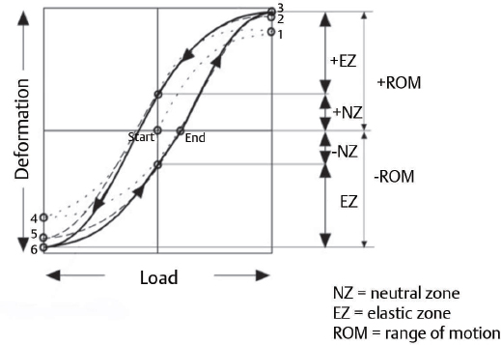
BEYOND ROM
ROM is moving in response to Torque!!!
We can think of torque as load and ROM as deformation
Spines aren’t linear elastic (at least, not always)
Instead, we see an S-shaped hysteresis curve
Because this curve is non-linear, ROM is not the same stiffness (slope of this curve)
Specimens have different stiffness at different parts of the curve
In fact, specimens with the same ROM can have different stiffnesses and vice-versa
Why is this important?
ROM is a limited parameter that can’t answer all questions about spinal biomechanics
We often use ROM as a metric to elude to other things like segmental stiffness, instability, motion preservation
But this is not always a direct measurement
With hysteresis curves, we can directly measure:
Instability, stiffness, non-linearity, energy dissipation

Slide 7
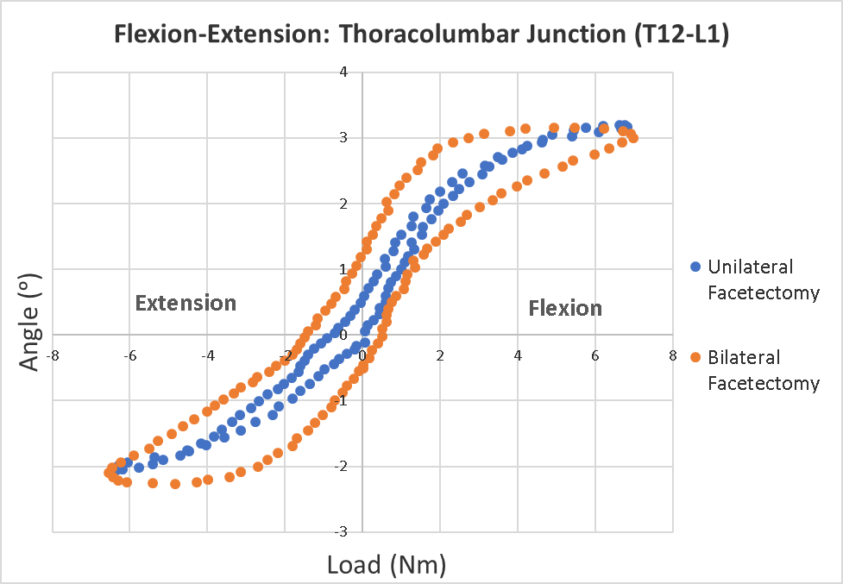
BEYOND ROM: Example
This is data from a T12-L1 specimen
There is similar ROM, but clearly, these curves are different
Can we still say motion is the same?

Slide 8
BEYOND ROM: Example
This is data from a T12-L1 specimen
There is similar ROM, but clearly, these curves are different
Can we still say motion is the same?
How do we analyze it???

Slide 9
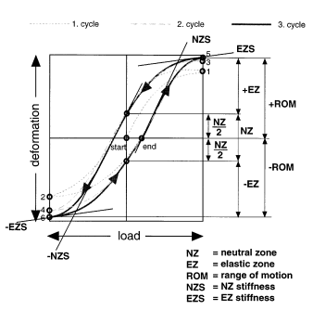
So you want to Analyze S-curves…
First need to know what an S-curve is...
Mechanical properties are time-, load-, and deformation-dependent
Also history-dependent, which is why the 6DOF preconditions the specimen with 2 cycles in FE, LB, AR
For our purposes, only data from the 3rd cycle is analyzed
In spine biomechanics, ideal hysteresis curves resemble S-shapes¹
Plot Load (Torque) vs. Deformation (Relative Angle)
Biphasic behavior (bottom-right and top-left curves)
Represents two-directional bending/torsion in the plane of interest
Flexion-Extension
Right LB-Left LB
Left AR-Right AR

Slide 10
So you want to Analyze S-curves…
Important Terms
Neutral Zone (NZ)¹:
A measure of laxity of the spinal specimen
Describes the range over which the spine moves freely without load
i.e. under its own weight
Used to measure instability compared to intact
LARGER NZ = MORE instability
Defined as the difference in angulation at zero-load between the 2-phases
These 2-points represent the positive (top) and negative (bottom) Neutral Zone Boundaries (NZBs)

Slide 11
So you want to Analyze S-curves…
Important Terms
Neutral Zone (NZ):
Elastic Zone (EZ)¹:
Deformation outside the NZ
From the end of the NZ to the maximum load and minimum load
Can think of these as positive (top) and negative (bottom) Ezs
There is no general definition to the EZ
It is generally thought of as the region outside of the NZ
But by the definition as the “stiffest region”, the analyzer application described here segments the region between the NZB and the min/max ROM into 3 parts based on their stiffnesses.
Here, the region with the greatest stiffness is formally defined as EZ

Slide 12
So you want to Analyze S-curves…
Important Terms
Neutral Zone (NZ):
Elastic Zone (EZ):
Neutral Position (NP)¹:
NP is the midpoint between these 2 points of angulation at zero-load
i.e. midpoint of NZ
Will ideally be close to the origin (0,0)
Unless drift or misaligned Load and ROM data

Slide 13
So you want to Analyze S-curves…
Important Terms
Neutral Zone (NZ):
Elastic Zone (EZ):
Neutral Position (NP):
Range of Motion (ROM)¹:
Total angulation of the specimen in the plane of motion (FE, LB, AR)
Describes how much motion there is in a specimen/construct
Can be split into positive & negative ROM based on the NP

Slide 14
So you want to Analyze S-curves…
Important Terms
Neutral Zone (NZ):
Elastic Zone (EZ):
Neutral Position (NP):
Range of Motion (ROM):
Neutral Zone Stiffness (NZS)¹:
Represents the lax deformation of the specimen/construct
Lowest stiffness in the S-curve
Is biphasic, just like NZ, so there is a positive (right) and a negative (left) NZS
Defined as the slope (deformation/load)of the NZ

Slide 15
So you want to Analyze S-curves…
Important Terms
Neutral Zone (NZ):
Elastic Zone (EZ):
Neutral Position (NP):
Range of Motion (ROM):
Neutral Zone Stiffness (NZS):
Elastic Zone Stiffness (EZS)¹:
Represents the elastic deformation of the specimen/construct
Is biphasic, just like EZ, so there is a positive (top) and negative (bottom) EZS
Defined as the slope at the stiffest region of the EZ starting from the max/min load

Slide 16
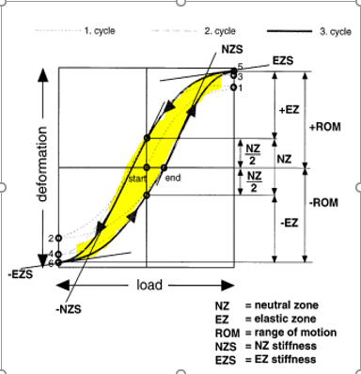
So you want to Analyze S-curves…
Important Terms
Neutral Zone (NZ):
Elastic Zone (EZ):
Neutral Position (NP):
Range of Motion (ROM):
Neutral Zone Stiffness (NZS):
Elastic Zone Stiffness (EZS):
Energy Dissipation¹:
Represents the viscoelastic/plastic behavior of the specimen/construct
Defined by the area under the hysteresis curve (can be normalized to ROM)^{2,5}
Greater area = more viscous behavior
Less area = more elastic behavior

Slide 17
So you want to Analyze S-curves…
Other Terms
Sigmoidity (NZS/EZS)
A measure of non-linearity of the mechanical properties of the specimen or construct
How much stiffness changes in the specimen
Greater sigmoidity = more linear elastic
Less sigmoidity = more non-linear

Slide 18
So you want to Analyze S-curves…
Other Terms
Instability
Often when the specimen is injured/degenerated
Considered unstable when ROM or NZ significantly changes from intact^{1,3}
NZ is considered a more direct estimate of instability⁴
NZ is considered more sensitive to detecting changes in motion due to spondylolisthesis and fracture^{4,5}
BUT findings with NZ depend on which method is used to find it, meaning if you find NZ with one method, you may not notice the same values or findings as if you were to analyze it with another method⁵
This analyzer used the Zero-Load method described by Wilke et al¹
Additional methods include:
Double Sigmoid
Stiffness Threshold
Extrapolated Elastic Zone
NZ Ratio or NZR (NZ/ROM)²
Used when ROM differs between specimens and groups
Describes how much of the motion is “unstable”

Slide 19
BEYOND ROM: Example
This is data from a T12-L1 specimen
There is similar ROM, but clearly, these curves are different
Can we still say motion is the same?

Slide 20

BEYOND ROM: Example
This is data from a T12-L1 specimen
There is similar ROM, but clearly, these curves are different
Can we still say motion is the same?

Slide 21
BEYOND ROM: Example
This is data from a T12-L1 specimen
There is similar ROM, but clearly, these curves are different
Can we still say motion is the same?
With hysteresis curve analysis we know:
NZ increased → MORE instability

Slide 22
BEYOND ROM: Example
This is data from a T12-L1 specimen
There is similar ROM, but clearly, these curves are different
Can we still say motion is the same?
With hysteresis curve analysis we know:
NZ increased → MORE instability
EZS increased → stiffer at extreme ROM, likely due to stretching of the disc and ligaments

Slide 23
BEYOND ROM: Example
This is data from a T12-L1 specimen
There is similar ROM, but clearly, these curves are different
Can we still say motion is the same?
With hysteresis curve analysis we know:
NZ increased → MORE instability
EZS increased → stiffer at extreme ROM, likely due to stretching of the disc and ligaments
Energy dissipation increased → more load focused on the disc

Slide 24
BEYOND ROM: Example
This is data from a T12-L1 specimen
There is similar ROM, but clearly, these curves are different
Can we still say motion is the same?
With hysteresis curve analysis we know:
NZ increased → MORE instability
EZS increased → stiffer at extreme ROM, likely due to stretching of the disc and ligaments
Energy dissipation increased → more load focused on the disc
Sigmoidity increased → more non-linear, more viscous behavior, not-as-smooth motion (more abrupt transitions between NZ and EZ)

Slide 25
BEYOND ROM: Example
This is data from a T12-L1 specimen
There is similar ROM, but clearly, these curves are different
Can we still say motion is the same?
With hysteresis curve analysis we know:
NZ increased → MORE instability
EZS increased → stiffer at extreme ROM, likely due to stretching of the disc and ligaments
Energy dissipation increased → more load focused on the disc
Sigmoidity increased → more non-linear, more viscous behavior, not-as-smooth motion (more abrupt transitions between NZ and EZ)
Ex: In a fused segment, expect lower instability, lower sigmoidity, low energy dissipation

Slide 26
Value of Hysteresis Curves
More detail than ROM, ROM does not represent all of spine biomechanics
More sensitive to changes in stability, stiffness, and certain anatomical changes
Can tell you things beyond total motion
How stiff is the construct? (NZS, EZS)
How stable is the construct? (NZ)
How smooth is the motion? (sigmoidity)
What is being loaded? Soft tissue or bony tissue? (sigmoidity, energy dissipation)
Sometimes ROM is enough
Pre- vs. Post-fatigue
Intact vs. Construct
Surgeons, PD, and Marketing won’t know what any of these metrics mean, other than ROM, so we have to explain it to them very clearly if we use them
But if what you are trying to capture needs a more sensitive metric or you want to explore the data more in-depth, use this analyzer

Slide 27
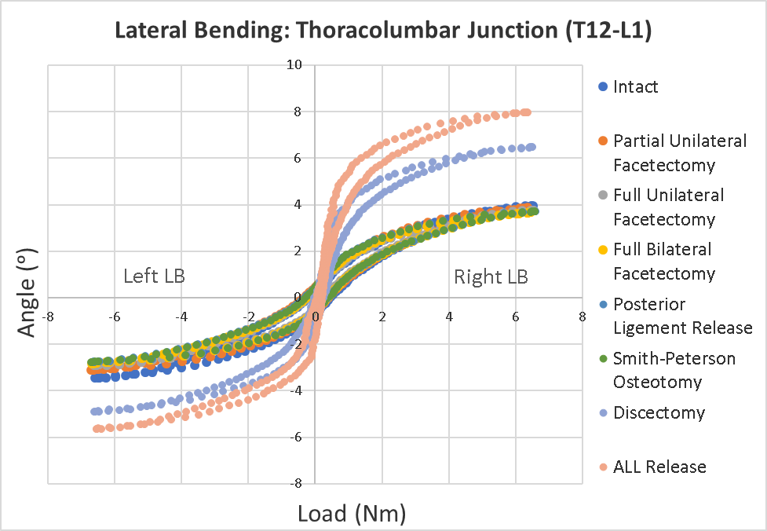
Value of Hysteresis Curves
Pretty pictures for your publications
More data to choose from to support your conclusions
With more data, we can say MORE about our products
Improves stiffness
Increases stability
Makes transition of motion smoother
Conducts loads more efficiently
Makes for a much more compelling paper

Slide 28
Limitations
Several assumptions are made that may not be completely accurate under all testing conditions
Pure bending moments:
Equal torque is applied to all levels, no resultant compression or tension, no axial compression
Allows us to use the SAME Load data at all levels and to analyze hysteresis curves for single-level and whole-spine OptoTrak data
Can analyze single- and multi-level constructs, if true, but focus your analysis on the construct levels
Hysteresis curve is in a normal S-shape
1st phase is below the 2nd phase, posNZB is always above the negNZB
No abnormal noise changing the curve shape
There are only 2 Zero-Load points
The spine only returns to a weightless position 2X

Slide 29
Limitations
If any of these assumptions are not met, this application is far less accurate
Ex. If pure bending moments are not applied, the torque data is not universal to every level
Additionally limited by alignment of OptoTrak & Load datasets
Improper alignment will result in incorrect hysteresis curves and inaccurate data
It is the responsibility of the user to validate
Also limited in ROM accuracy
The application smoothens and reduces the resolution of OptoTrak data
As such, ROM is typically reported as 0-2⁰ less than it actually is, so use the 6DOM ROM ANALYZER to accurately report ROM

Slide 30
References
Wilke HJ, Wenger K, Claes L. Testing criteria for spinal implants: recommendations for the standardization of in vitro stability testing of spinal implants. Eur Spine J. 1998;7(2):148-154. doi:10.1007/s005860050045
Zirbel SA, Stolworthy DK, Howell LL, Bowden AE. Intervertebral disc degeneration alters lumbar spine segmental stiffness in all modes of loading under a compressive follower load. The Spine Journal. 2013;13(9):1134-1147. doi:10.1016/j.spinee.2013.02.010
Wilke HJ, Herkommer A, Werner K, Liebsch C. In vitro analysis of the segmental flexibility of the thoracic spine. PLoS One. 2017;12(5):e0177823. Published 2017 May 16. doi:10.1371/journal.pone.0177823
Tan E, Wang T, Pelletier MH, Walsh WR. Effects of cement augmentation on the mechanical stability of multilevel spine after vertebral compression fracture. Journal of Spine Surgery. 2016;2(2):111-121. doi:10.21037/jss.2016.06.05
Di Pauli von Treuheim T, Zengerle L, Hecht AC, Iatridis JC, Wilke HJ. Does the neutral zone quantification method matter? Efficacy of evaluating neutral zone during destabilization and restabilization in human spine implant testing. J Biomech. 2021;129:110756. doi:10.1016/j.jbiomech.2021.110756

Slide 31
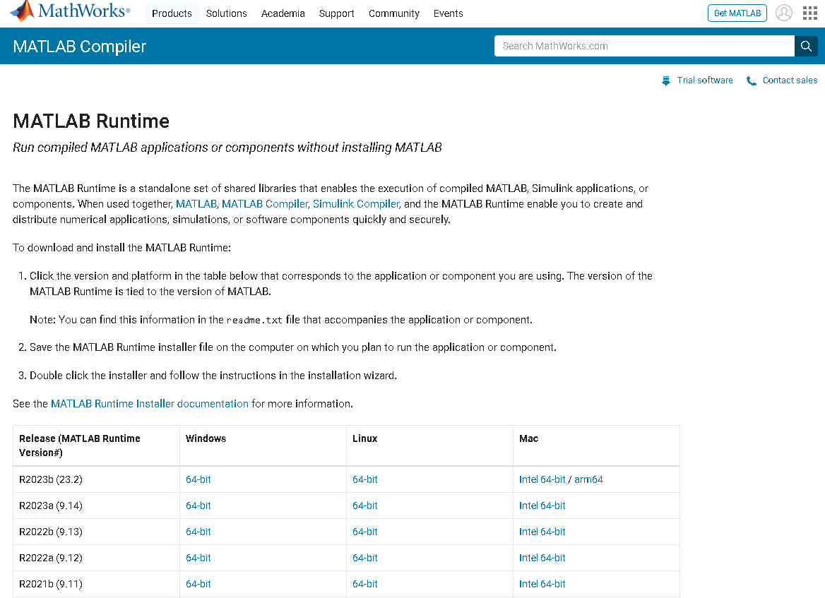
Installing Load vs. Displacement analyzer
Install MATLAB Runtime R2022a (9.12)
Need this version to run the application

Slide 32
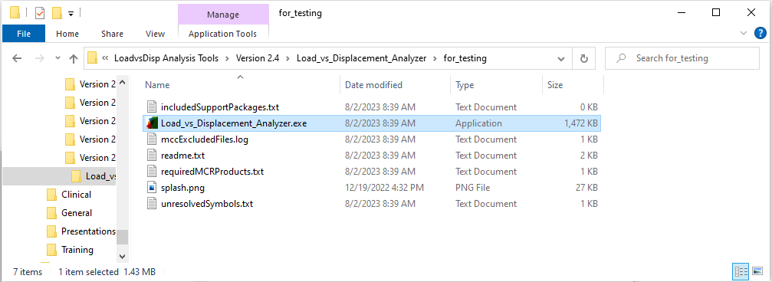
Running Load vs. Displacement analyzer
Go to the server and start the application
\\SW10FIL01\Research\Research Operations\Biomechanical\Software\LoadvsDisp Analysis Tools\Version 2.4\Load_vs_Displacement_Analyzer\for_testing

Slide 33
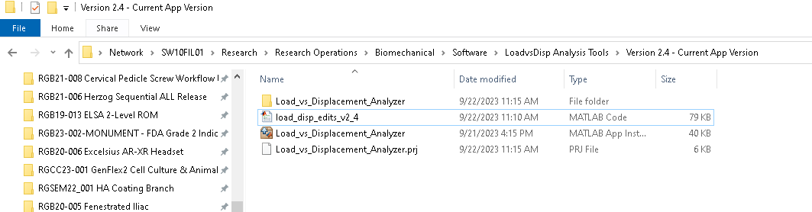
Running Load vs. Displacement analyzer
OR use the MATLAB code
\\SW10FIL01\Research\Research Operations\Biomechanical\Software\LoadvsDisp Analysis Tools\Version 2.4 - Current App Version.load_disp_edits_v2_4.m
Just make sure to go to add-ons and verify that the Statistics and Machine Learning toolbox and Signal Processing toolbox are installed

Slide 34
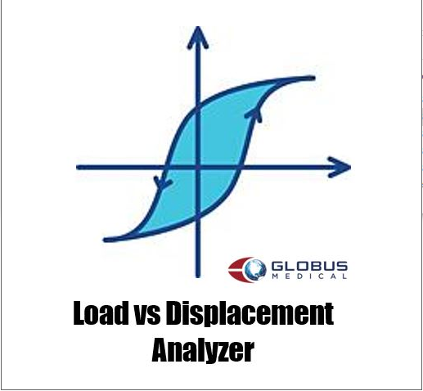
Running Load vs. Displacement analyzer
The application will start as indicated by the following popup icon

Slide 35
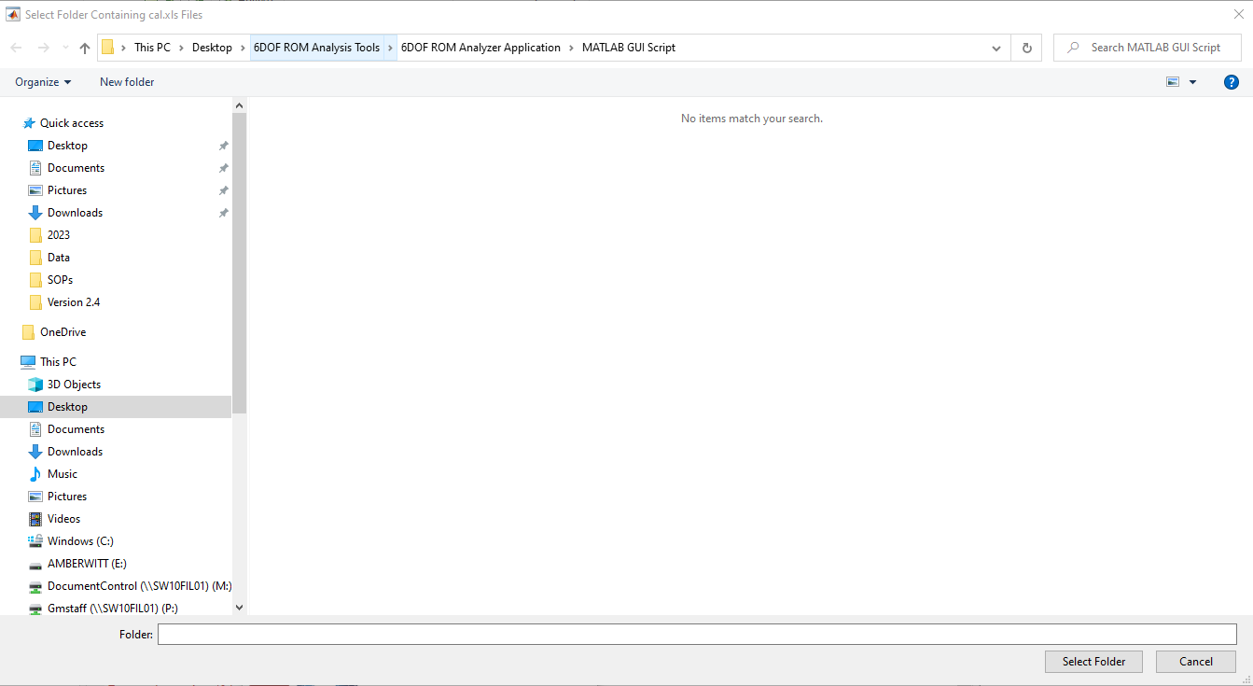
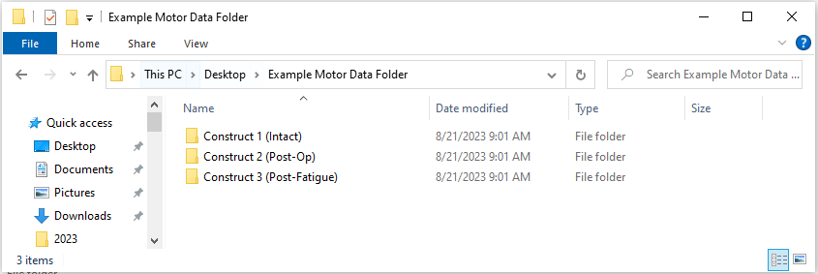
Running Load vs. Displacement analyzer
Select the motor data
Select the folder containing the load files (Books) for the construct being analyzed

Slide 36
Running Load vs. Displacement analyzer
Select the OptoTrak data
Select the folder containing the cal.xls files for the construct being analyzed

Slide 37
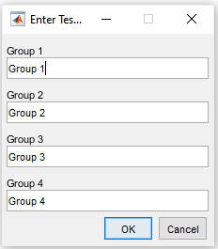
Running Load vs. Displacement analyzer
Name the construct groups
Fill in the specimen number and construct with any info needed to identify the construct

Slide 38
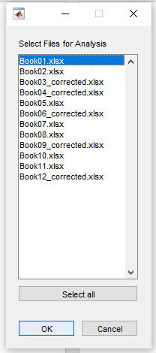
Running Load vs. Displacement analyzer
Select the files for analysis
Select any files that are of interest in your analysis
These books correspond to FE, LB, AR for the specimens in the selected folder in order (always in this order)
It is recommended to only select one at a time and then re-run the application for the remaining files to avoid not having your work saved if there is a problem with one of these files, the program only outputs a data summary after it has successfully analyzed all the selected files

Slide 39
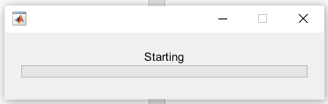
Running Load vs. Displacement analyzer
Progress bar
A progress bar will pop up indicating where the program is with the analysis

Slide 40
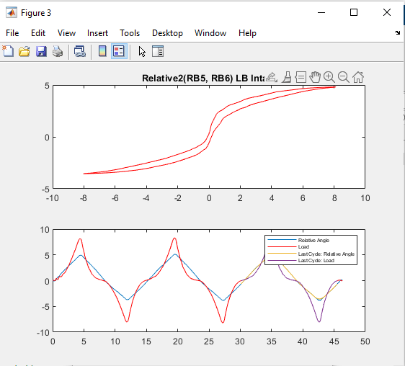
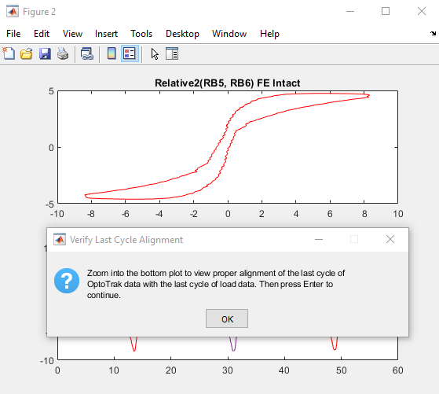
Running Load vs. Displacement analyzer
Verify the alignment of the data
A new popup figure will show the hysteresis curve (top) and the 3rd cycle of OptoTrak vs. Time and Load vs. Time data (bottom) as seen by the application
Make sure that:
The hysteresis curve resembles the distinctive S-shape
The peaks from the OptoTrak data align with those of the Load data
Failure to ensure 2 will result in an inaccurate hysteresis curve

Slide 41
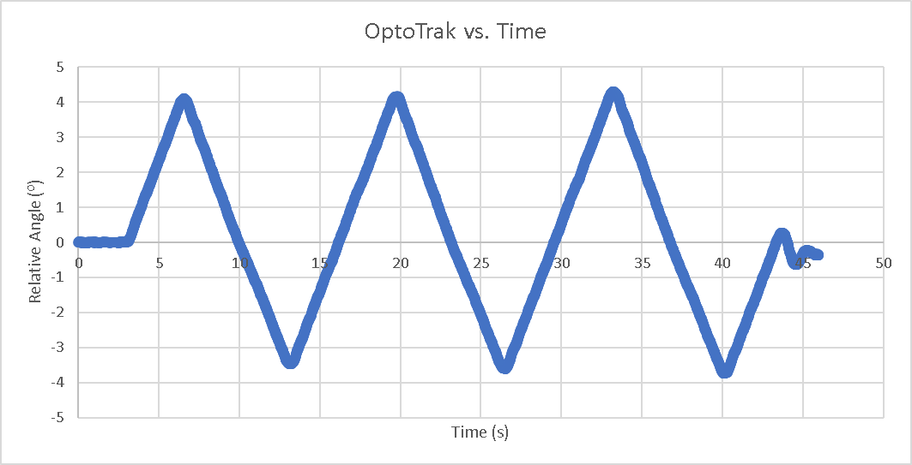
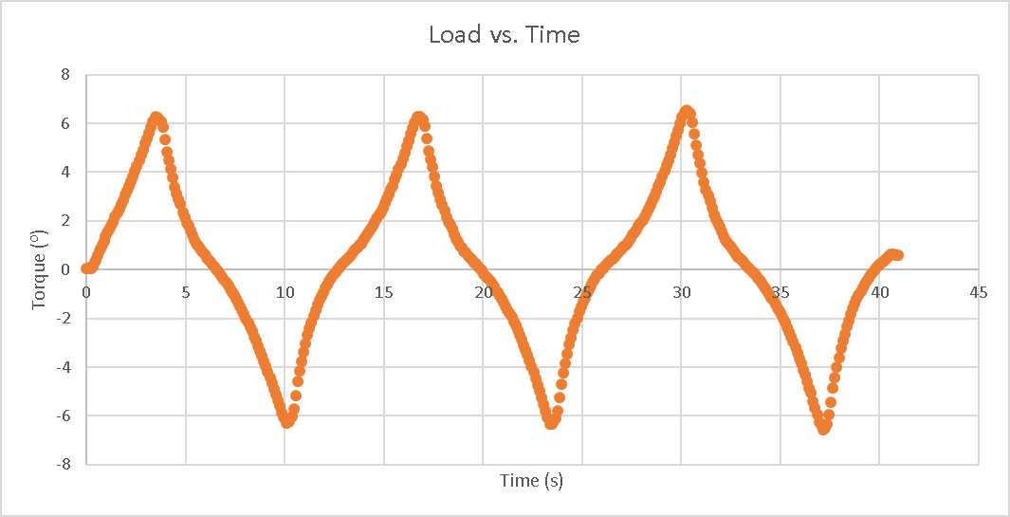
Running Load vs. Displacement analyzer
Verify the alignment of the data
This step is crucial and can be prone to error
To identify the 3rd cycles, the application counts the number of peaks and valleys and determines the starting point for each cycle as when the OptoTrak vs. Time or Load vs. Time data intersects zero (i.e. the x-axis) which is representative of the starting position or load, respectively
Because the OptoTrak Motion Capture System collects data at a much higher rate (~100 Hz) than the 6DOF Load Cell (~10 Hz), much of the OptoTrak data needs to be negated in order for these two datasets to be aligned
Additionally, the OptoTrak Motion Capture System starts collecting before the 6DOF Load Cell which causes a delay in the OptoTrak vs. Time data that the application needs to “chop off” in order to align the two datasets
There can calls be extra data at the end of the OptoTrak vs. Time dataset because this is turned off after the 6DOF Load Cell terminates data collection

Slide 42
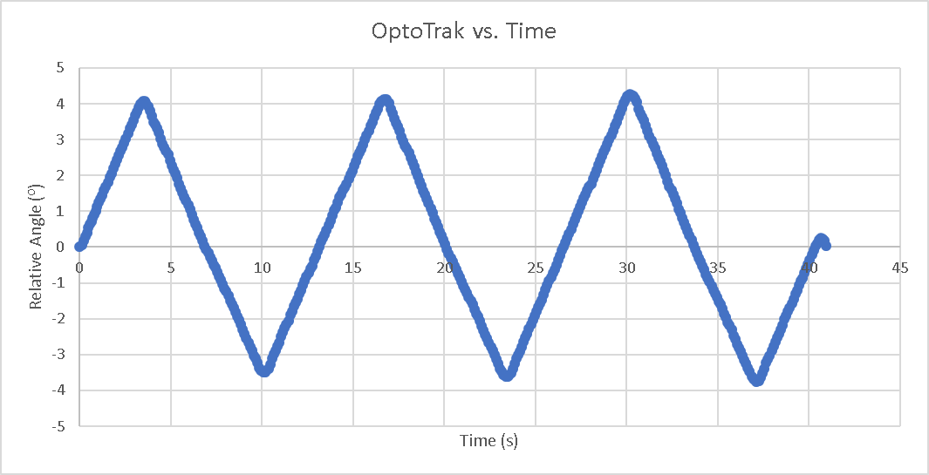
Running Load vs. Displacement analyzer
Verify the alignment of the data
This step is crucial and can be prone to error
The algorithm does its best to chop off this excess OptoTrak data on its own, but sometimes it is not enough and the user needs to manually edit the data in Excel
The failure of the algorithm to chop off the data causes it to misinterpret which cycle is the last cycle and where said cycle starts, which affects the hysteresis curve

Slide 43
Running Load vs. Displacement analyzer
Verify the alignment of the data
This step is crucial and can be prone to error
The algorithm does its best to chop off this excess OptoTrak data on its own, but sometimes it is not enough and the user needs to manually edit the data in Excel
The failure of the algorithm to chop off the data causes it to misinterpret which cycle is the last cycle and where said cycle starts, which affects the hysteresis curve

Slide 44
Running Load vs. Displacement analyzer
Verify the alignment of the data
This step is crucial and can be prone to error
The algorithm does its best to chop off this excess OptoTrak data on its own, but sometimes it is not enough and the user needs to manually edit the data in Excel
The failure of the algorithm to chop off the data causes it to misinterpret which cycle is the last cycle and where said cycle starts, which affects the hysteresis curve

Slide 45
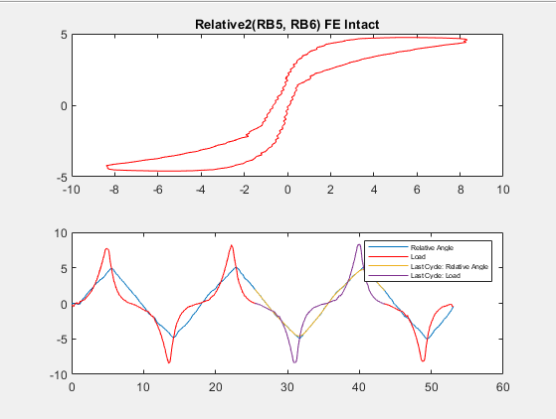
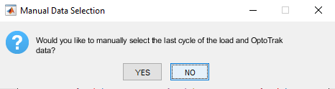
Running Load vs. Displacement analyzer
Manual Data Selection
Press “Enter” and a new popup message will appear
Press “YES” if the hysteresis curve looks off or there is misalignment between the peaks of the OptoTrak vs. Time and Load vs Time data
Otherwise press “NO” and continue to slide 49

Slide 46
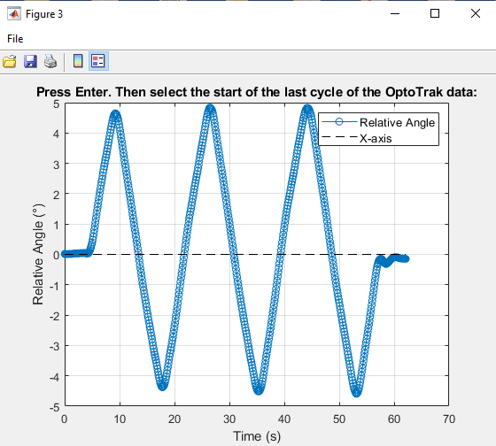
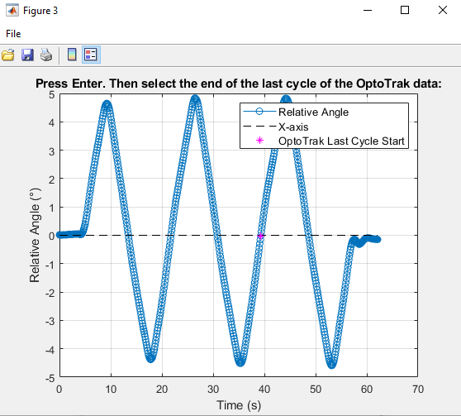
Running Load vs. Displacement analyzer
Manual Data Selection: “YES”
If “YES” is pressed, a new popup figure will appear showing the OptoTrak vs. Time data with the reduced resolution (~10 Hz)
Follow the instructions to manually select the start and end points of the 3rd cycle of OptoTrak vs. Time data

Slide 47
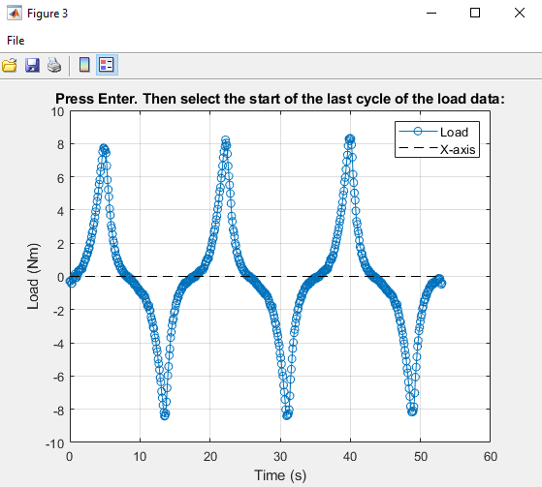
Running Load vs. Displacement analyzer
Manual Data Selection: “YES”
A new popup figure will appear showing the Load vs. Time data
Follow the instructions to manually select the start of the 3rd cycle
As two vectors that will be combined, the OptoTrak vs. Time and Load vs. Time datasets need to have the same number of data points
The endpoint of the 3rd cycle of the Load vs. Time dataset will be determined by the number of data points between the selected start and end points in the 3rd cycle of the OptoTrak vs. Time dataset

Slide 48
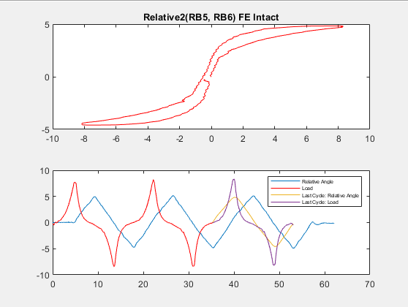
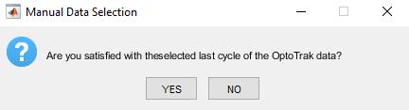
Running Load vs. Displacement analyzer
Manual Data Selection: “YES”
A new popup figure will appear showing the updated hysteresis curve
Load vs. Time data will remain the same, but raw OptoTrak vs. Time data will be plotted with the lag
Shows the data as it was pre-analysis
The 3rd cycle of the OptoTrak vs. Time data will be shifted based on the starting point selected in the previous two figures and should be aligned with the 3rd cycle of the Load vs. Time data
Press “YES” if the data alignment and the hysteresis curve are satisfactory (continue to slide 49)
Note: This type of “lag chopping” can be done outside of the application in the cal files
Otherwise, press “NO” and re-select the 3rd cycle of OptoTrak vs. Time and Load vs. Time (slides 46-47)

Slide 49
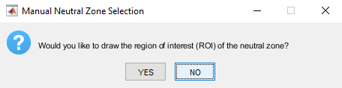
Running Load vs. Displacement analyzer
Manual Neutral Zone Selection:
If the 3rd cycle of OptoTrak vs. Time and Load vs. Time data are aligned and properly selected, yet the hysteresis curve still looks odd press “YES”
Reasons for abnormal hysteresis curves:
Discontinuities: Common at very low ROM and drift
Noise: This application finds the NZ using the Zero Load method described by Wilke et al¹ but there are many others⁵ that could be used. Therefore, if there are more than two intersections with the y-axis, often due to noisy data, the application cannot identify the NZ
Non-sensical data: segment anatomy or loading rate prevents the smooth transition between cycles, resulting in a hysteresis curve that doesn’t resemble an S-shape
Otherwise, press “NO” and continue to slide 66
The hysteresis curve looks as it should or as good as it will ever look

Slide 50
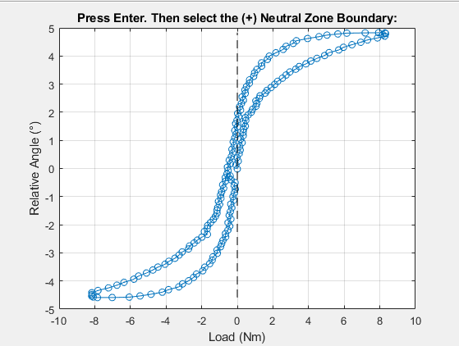
Running Load vs. Displacement analyzer
Manual Neutral Zone Selection: “YES”
A new popup figure will appear showing the hysteresis curve
The dashed line represents the x-axis that is used in the Zero Load method
Ideally the hysteresis curve starts and ends around the origin (0,0)
Seen in the 1st phase (bottom-right) of the hysteresis curve as the 2 points on opposite sides of the x-axis, closest to the x-axis

Slide 51
Running Load vs. Displacement analyzer
3rd Cycle Start
3rd Cycle End

Slide 52
Running Load vs. Displacement analyzer
1st Phase
2nd Phase
3rd Cycle Start
3rd Cycle End

Slide 53
Running Load vs. Displacement analyzer
3rd Cycle Start
3rd Cycle End

Slide 54
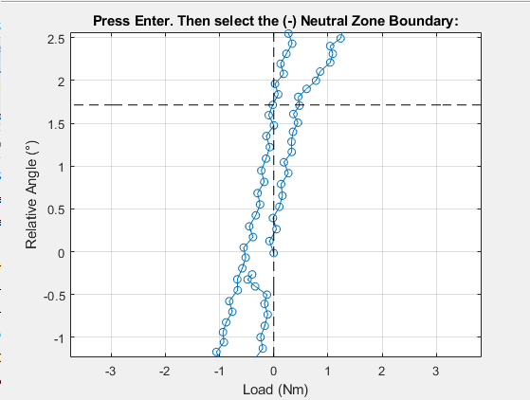
Running Load vs. Displacement analyzer
Manual Neutral Zone Selection: “YES”
Zoom in, press “Enter”, and select the positive NZB (posNZB)
A new dashed line will appear at the posNZB
Remember, this is where the 2nd phase (top-left) of the hysteresis curve intersects with the x-axis (i.e. zero-load)

Slide 55
Running Load vs. Displacement analyzer

Slide 56
Running Load vs. Displacement analyzer
2nd phase point closest to X-axis
posNZB
X-axis
Zero-Load

Slide 57
Running Load vs. Displacement analyzer
Manual Neutral Zone Selection: “YES”
Press “Enter” and select the negative NZB (negNZB)
A new dashed line will appear at the negNZB
If there is a discontinuity, select the starting point of the hysteresis curve as negNZB

Slide 58
Running Load vs. Displacement analyzer

Slide 59
Running Load vs. Displacement analyzer
1st phase point closest to X-axis
(always the origin)
posNZB
X-axis
Zero-Load
negNZB

Slide 60
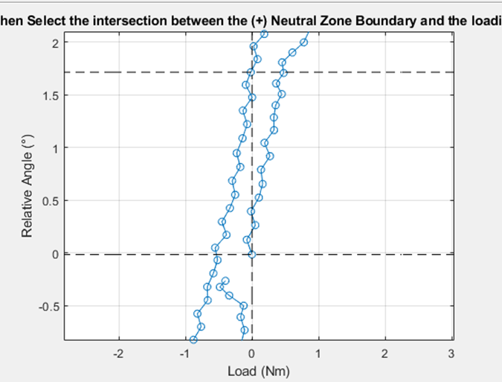
Running Load vs. Displacement analyzer
Manual Neutral Zone Selection: “YES”
Press “Enter” and select the points of the 1st phase that intersect the posNZB
All points between the posNZB and negNZB in the first phase will turn red

Slide 61
Running Load vs. Displacement analyzer

Slide 62
Running Load vs. Displacement analyzer
Points where 1st phase intersects posNZB
posNZB
1st phase
negNZB

Slide 63
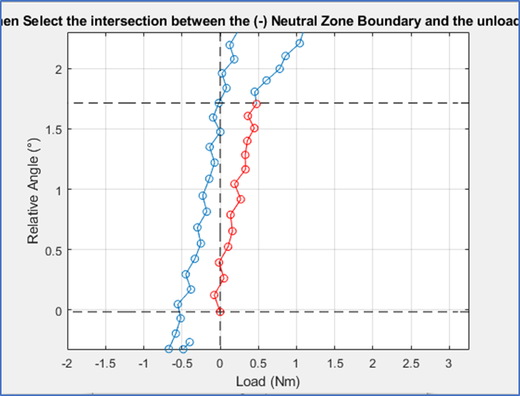
Running Load vs. Displacement analyzer
Manual Neutral Zone Selection: “YES”
Press “Enter” and select the points of the 2nd phase that intersect the posNZB
All points between the posNZB and negNZB in the 2nd phase will turn red before the figure closes itself

Slide 64
Running Load vs. Displacement analyzer

Slide 65
Running Load vs. Displacement analyzer
posNZB
2nd Phase
Points where 2nd phase intersects negNZB
negNZB

Slide 66
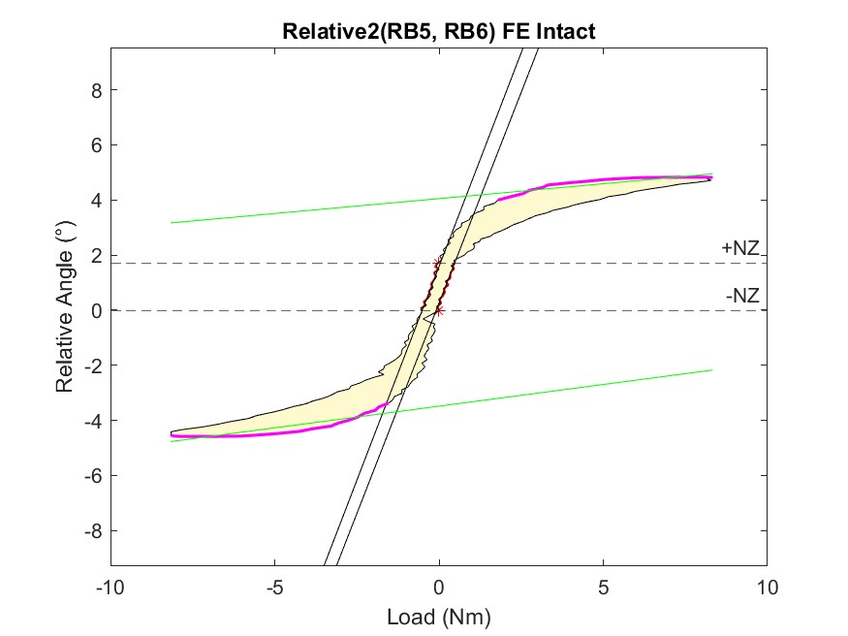
Running Load vs. Displacement analyzer
Analyzed Hysteresis Curve
The hysteresis curve will be annotated with the features assessed during the analysis:
posNZB: Top “*”
posNZB: Bottom “*”
NZ: red region
posNZS: right-most black line
negNZS: left-most black line
posEZ: top magenta region
negEZ: bottom magenta region
posEZS: top green line
posEZS: bottom green line
Hysteresis: yellow area within the curve
This figure is saved automatically for visual confirmation of the extracted features

Slide 67
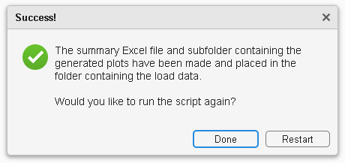
Running Load vs. Displacement analyzer
Run Again or Close
After the application has analyzed all the selected OptoTrak and Load files, a final pop-up will appear asking the user if they would like to run the script again.
Press “Restart” to re-analyze or analyze more files
Press “Done” to close the application
Before choosing, make sure to verify the accuracy of the output data

Slide 68
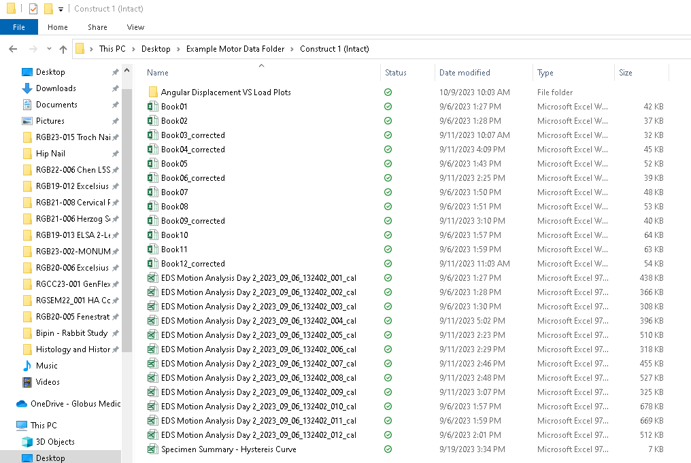
Running Load vs. Displacement analyzer
Verify Data
In the folder containing the OptoTrak data used in this analysis, there should appear a new Excel spreadsheet called “Specimen Summary – Hysteresis Curve.xls”

Slide 69
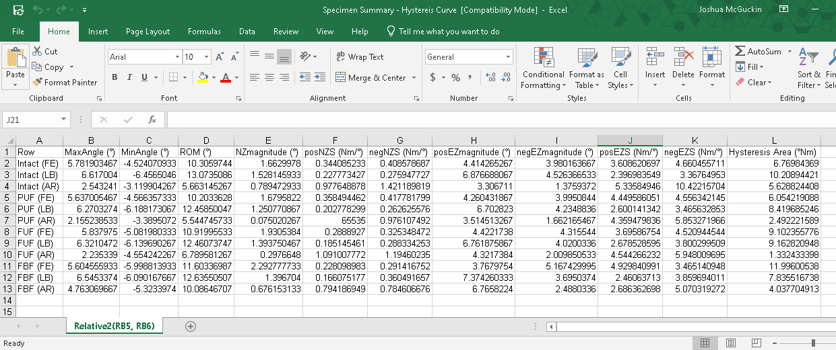
Running Load vs. Displacement analyzer
Verify Data
In this spreadsheet, there will be a tab for each relative analyzed
In each tab there will be a table with rows for every cal and Book file combination analyzed (FE, LB, or AR for every construct) with all the extracted data from the hysteresis curve
From these parameters other metrics can be calculated
Sigmoidity: NZS/EZS
Normalized NZ: NZ/ROM
It should be noted that because the resolution of the OptoTrak data is reduced to make it compatible with the Load data, the ROM in the hysteresis curve might be less than the ROM of the raw OptoTrak data
Differences between raw and process ROM are typically between 0-2⁰ and must be evaluated before using ROM in any part of the greater analysis

Slide 70
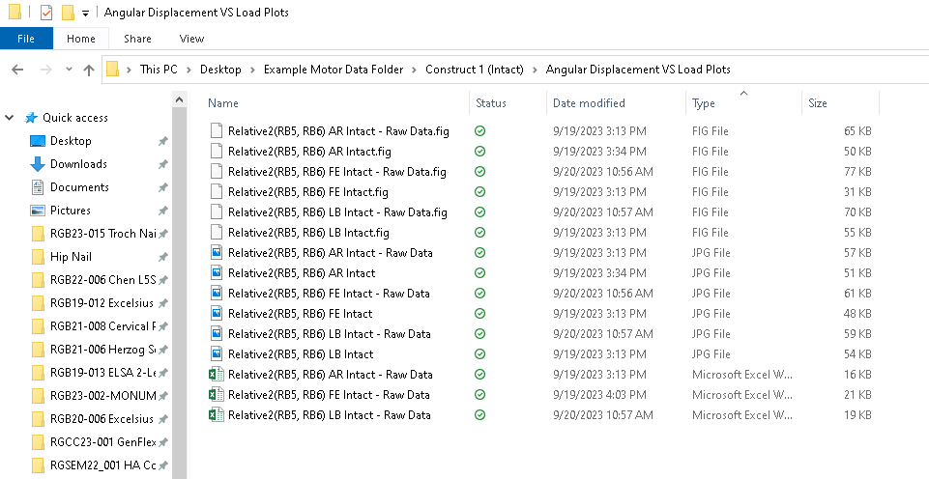
Running Load vs. Displacement analyzer
Verify Data
In the folder containing the Load data used in this analysis, there should appear a new folder called “Angular Displacement VS Load Plots”
In this folder, there will be 3 types of files for every cal and Book file combination analyzed
These will include JPEGs, MATLAB Figs, and Excel spreadsheets
JPEGs and MATLAB Figs have the annotated hysteresis curves for reference and verification of data

Slide 71
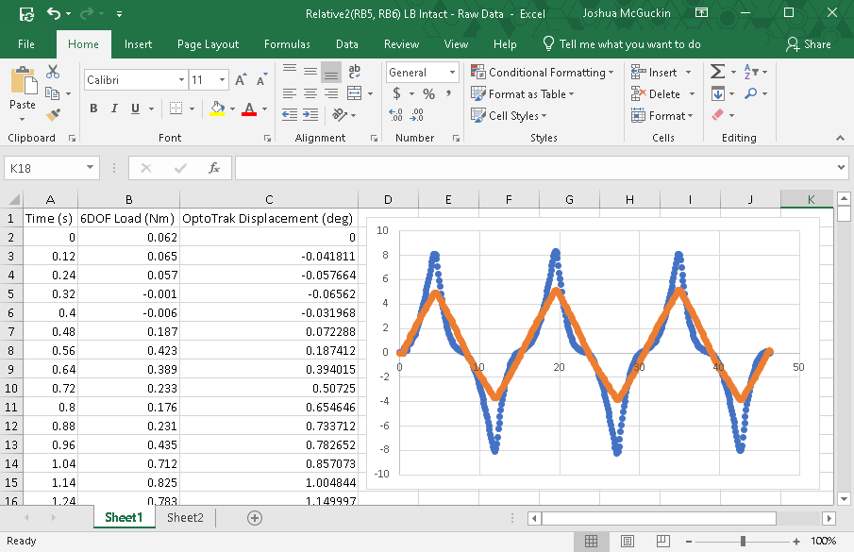
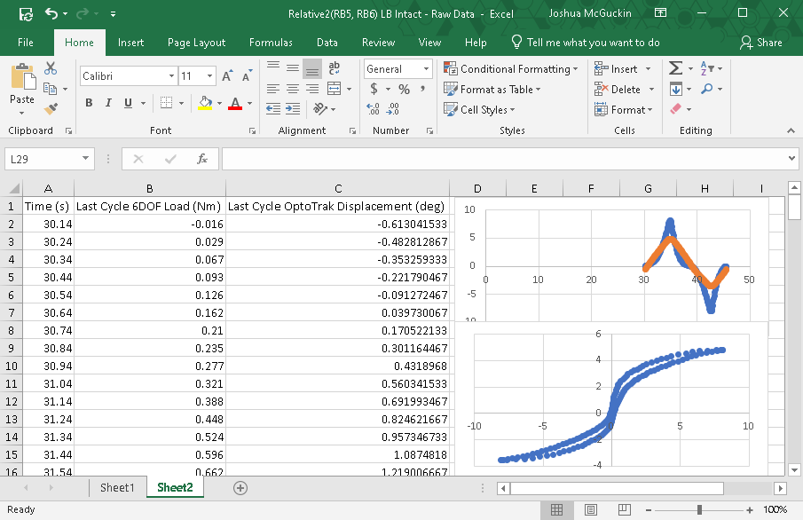
Running Load vs. Displacement analyzer
Verify Data
In the folder containing the Load data used in this analysis, there should appear a new folder called “Angular Displacement VS Load Plots”
In this folder, there will be 3 types of files for every cal and Book file combination analyzed
These will include JPEGs, MATLAB Figs, and Excel spreadsheets
JPEGs and MATLAB Figs have the annotated hysteresis curves for reference and verification of data
Excel spreadsheets have all the processed data (3 cycles of time, displacement, load) and the data for the hysteresis curve (last cycle time, displacement, and load) that was analyzed by the application
These can be used to re-create and manually re-analyze the hysteresis curves if necessary
If the hysteresis curve looks as expected, the user can usually trust the results; however, if the curve looks “wonky”, the user should consider correcting the OptoTrak data in the application (slides 46-47) or in the cal or Book files or manually extracting parameters in the output Excel spreadsheets

Slide 72
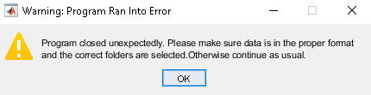
Running Load vs. Displacement analyzer
Fatal Errors
If, for whatever reason, the application encounters a fatal error that prevents it from running the analysis, a warning message will pop up before the program closes
There are a number of reasons that this may occur, but some of the most common include:
Problems accessing data on the server, often because path names are too long
Discontinuities in the OptoTrak data usually due to blocked rigid bodies
Severely abnormal OptoTrack data where peaks cannot be determined (e.g. high drift or extremely low ROM)
Extra columns in the OptoTrak data that are not part of the original output (e.g. when normalizing relatives)
Mismatch in the number of OptoTrak and Load files
Too much lag in the OptoTrak data

